Slide 1
DIFFERENCE BETWEEN NoSQL & SQL
MongoDB VS SQL

Slide 2
SQL VS NoSQL
SQL databases are relational.
SQL databases are vertically scalable.
SQL databases are better for multi-row transactions.
NoSQL databases are non-relational.
NoSQL databases are horizontally scalable.
while NoSQL is better for unstructured data like documents or JSON.

Slide 3
COMPARISON OF MongoDB & NoSQL
MongoDB
NoSQL
MongoDB is a more dynamic and complicated choice that is appropriate for hierarchical data because of its fundamental properties.
NoSQL is still more predetermined and appropriate for other types of data storage.

Slide 4
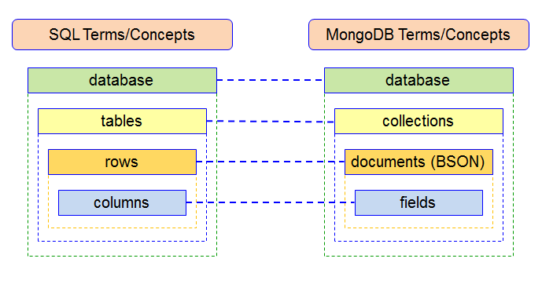

Slide 5
At a high level, NoSQL and SQL databases have many similarities. In addition to supporting data storage and queries, they both also allow one to retrieve, update, and delete stored data. However, under the surface lie some significant differences that affect NoSQL versus SQL performance, scalability, and flexibility.

Slide 6
THANK YOU!

